Slide 1
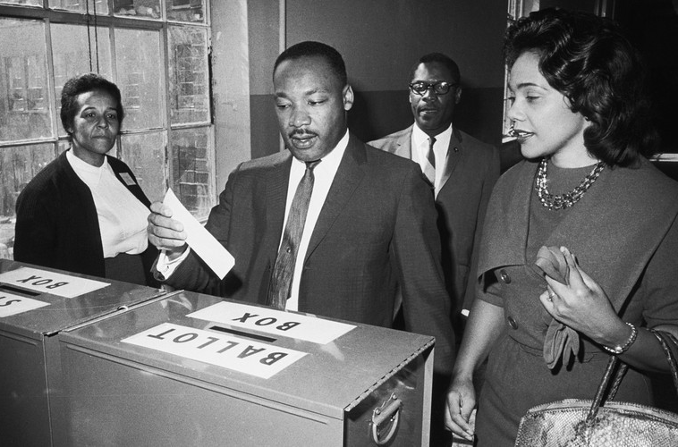

Honoring Dr. Martin Luther King
2022
“So long as I do not firmly and irrevocably possess the right to vote I do not possess myself. I cannot make up my mind – it is made up for me.”
-Dr. Martin Luther King

Slide 2
What’s at stake
This year, the family of Dr. Martin Luther King Jr. has requested that Americans honor Dr. King’s legacy by supporting equitable voting legislation, which is currently in a vulnerable and precarious state.
In 2020, it became illegal to hand out food or water to people standing in line to vote in Georgia.
In 2021, the U.S. Supreme Court upheld a law that will deleteriously impact BIPOC voters’ ability to challenge state laws in Arizona.
In 2021, major changes were made to voting laws to make voting more difficult in Texas.
In 2021, several similar bills to protect national voting rights were blocked.

Slide 3
Resources
The Rutland Area and Windham County NAACP Branches are encouraging education over celebration this year.
The Freedom to Vote Act
John Lewis Voting Rights Advancement Act
Martin Luther King Jr.'s family calls for 'no celebration' of MLK Day without action on voting rights legislation
Lifting as We Climb: Black Women's Battle for the Ballot Box, by Evette Dionne
The racist 1890 law that’s still blocking thousands of Black Americans from voting
Voting Rights Act

